Slide 1
Action Potential Propagation in Cardiac Tissue: An Agent-Based Approach
Brady Berg, Joseph McGuire
Advised by Dr. Joyce Lin, Dr. Elena Dimitrova

Slide 2
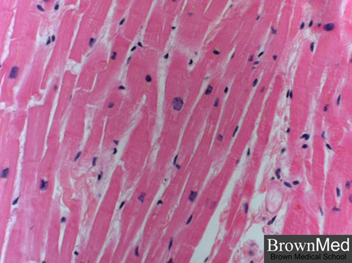
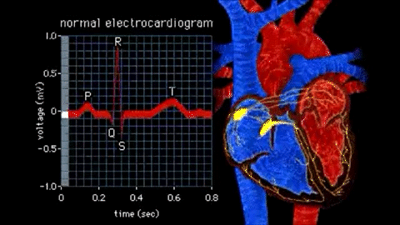
Background
Electrical activity in the heart results in the pumping of blood
Action potentials travel end-to-end through cells, forming a wavefront of depolarized cells
We are interested in understanding how action potentials propagate, as propagation failure has been linked to cardiac arrhythmias

Slide 3
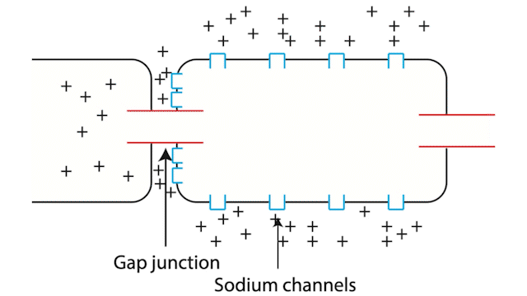
Gap junctions and voltage-gated sodium ion channels are key to the propagation of an action potential.

Slide 4
Why Use Agent-Based Modeling (ABM)?
Shortfalls of traditional models
Use complex ODEs, PDEs that require understanding of macroscopic system dynamics
Often lose geometric data (e.g., due to lumped parameter models or tissue homogenization)
May be difficult to visualize
No accounting for ion depletion
Advantages of ABM
Simple rules govern behavior in a small neighborhood of each agent
Give rise to macroscopic phenomena
Geometry intrinsic to model design
Instant visualization (in NetLogo)
Ion depletion can be studied

Slide 5
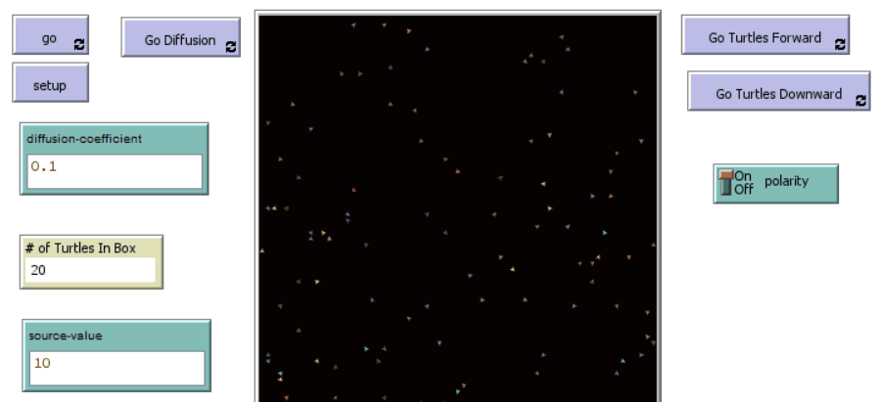
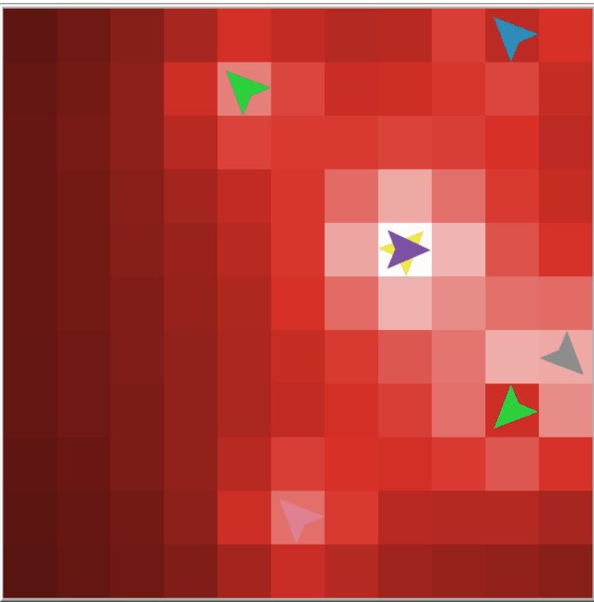
Ion Movement and Diffusion
Issues with Top Model
Diffusive model that fails to create a proper “grading” for voltage (Q / R)
Computationally expensive to implement w/particle interactions
Bottom Potential
Implements the proper scaling for potential ( Q / R )
See the right behavior of ion clusters being repulsed from each other
Notes:
So for Joe’s approach to the problem, here’s a quick update on that:
If you’ll recall from the previous presentation, this can be seen in the top right, turtle movement was determined by a centrally located cell with a high potential variable, that then diffuses across the “cell”. This establishes a gradient that the turtles then can follow to file into the cell. This roughly reproducing the process of “Depolarization”
The major issues here is that the diffusion failed to have a correct grading of Q / R and failed to implement a turtle-field interaction
The bottom image here shows the new model
This new model calculates potential patch by patch, using the electrostatic formula of charge over potential.

Slide 6

Cell Depolarization

Slide 7
Future Work
Assess validity of neighborhood-based ion flow as compared to full calculation of potential map
Incorporate capacitive current effects
Requires time scale
Refine ion movement
Diffusion speed may vary intracellularly vs. extracellularly
Ions experiencing higher voltage drops should move faster
Chain together more cells
Higher dimensions

